Slide 1
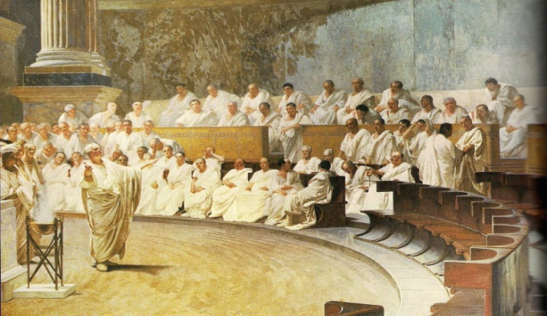
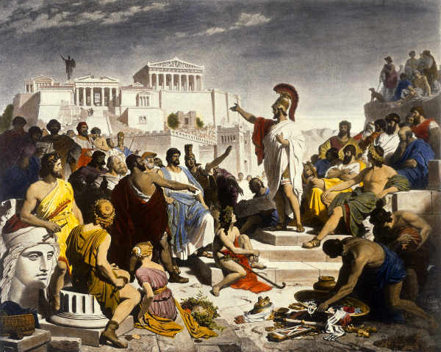
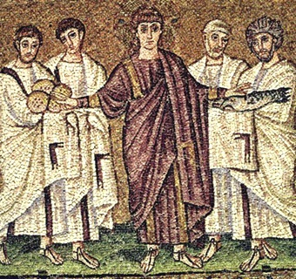
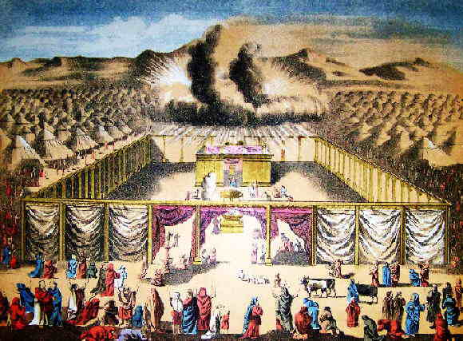
Respecting the Origins of Democracy
Presentation by Sharon Wilson and Elizabeth Ramos

Slide 2
Standard 10.1 Students relate the moral and ethical principles in ancient Greek and Roman Philosophy, in Judaism, and in Christianity to the development of Western political thought.
10.1.1 Analyze the similarities and differences in Judeo-Christian and Greco-Roman views of law, reason and faith, and duties of the individual.
10.1.2 Trace the development of the Western political ideas of the rule of law and illegitimacy of tyranny, using selections from Plato’s Republic and Aristotle’s Politics.
10.1.3 Consider the influence of the U.S. Constitution on political systems in the contemporary world.

Slide 3
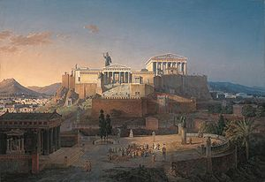
Types of Government in Ancient Greece
About 2000B.C.- the Greeks developed the first types of Government
Greece was split in multiple city-states; independent cities and surrounding regions under a unified government
Each city-state had its own type of government

Slide 4
Major forms of Government in Ancient Greece
Monarchy: State ruled by a king Rule is hereditary Some rulers claim divine rights (king’s power came from God) | Aristocracy: State ruled by nobility Rule hereditary and based on family ties, social rank, wealth Social status and wealth support rulers’ authority
Oligarchy: State ruled by a small group of citizens Rule is based on wealth or ability Ruling group controls military | Direct Democracy: State ruled by its nobility Rule is based on citizenship Majority rule decides vote

Slide 5
Current World Governments

Slide 6
Building Democracy
From Greek demos means “people” and kratos means “power”
Athens, the largest and the most powerful city-state in Ancient Greece
The first democratic ideas evolved from the citizen participation in governmental decision making, in Athens
Each year an assembly of citizens elected three nobles to rule the city state
After a year of service the nobles became a part of a larger council of advisers

Slide 7
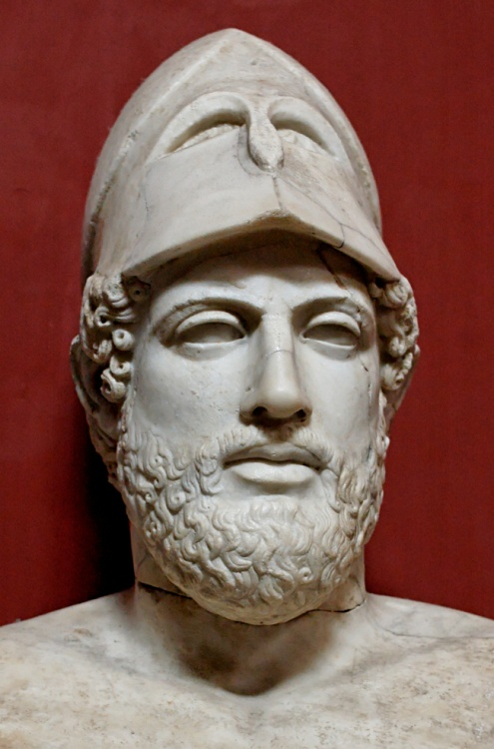
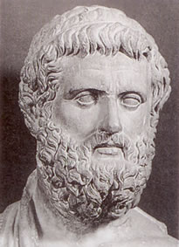
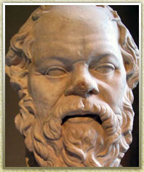
Around 600 B.C. Athens suffered economic problems. Several political figures emerged that would deal with these issues before they ruined Athens….
Solon
Pericles
Socrates
The Reformers of Athens who applied great thinking to aspects of life.

Slide 8
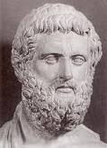
Solon
Athenian statesman. He ended exclusive aristocratic control of the government, substituted a system of control by the wealthy, and introduced a new and more humane law code. He was also a noted poet.
Passed law outlawing slavery based on debt
Law allowed Athens to avoid revolution or civil war
Created a social class based on wealth not heredity
Created Council of Four Hundred
Introduced concept of any citizen pressing charges on wrong doers
Solon’s new legal concept of citizens bringing charges onto wrongdoers increased citizen participation in government. However, Athens was still limited as a democracy.

Slide 9
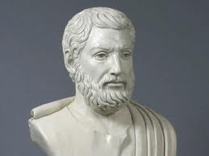
Cleisthenes
Considered “founder of democracy” in Athens
Reorganized the assembly to balance power between poor and rich
Allowed citizens to submit laws for debate and passage
Let citizens participate in a limited democracy
Cleisthenes reforms worked to make Athens a full democracy. It is important that he balanced the power between the rich and poor so that every citizen could have a say in their government.

Slide 10
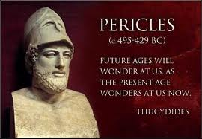
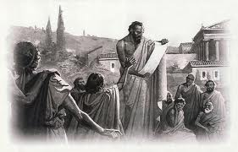
Pericles and Greek Reason
Increased number of paid government officials and paid jurors to strengthen democracy
Enabled poor citizens to participate
Transformed Athens into a direct democracy
Philosophers in Athens believed in logic and reason
Believed that the world was put together in an orderly way and unchanging laws
Believed people can understand these laws through logic and reason
Several Greek philosophers appeared during the 4th century B.C. in Athens

Slide 11
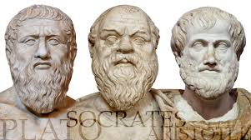
Greek Philosophers
Plato
Wrote “The Republic”
Expressed ideas of perfectly governed society
Expressed ideas of a society ruled by the wisest people
- “philosopher kings”
Socrates
Encouraged students to examine their most important beliefs
Used a question and answer method later known as the Socratic method
Greatest student was Plato
Aristotle
Examined nature of the world
In “Politics”, he wrote, “Man is by nature a political animal…”

Slide 12
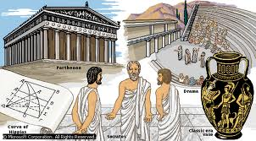
Legacy of Greek Government
Set lasting standards in government and philosophy
Developed Direct Democracy
First to develop three branches of government
-Executive
- Legislative
- Judicial

Slide 13
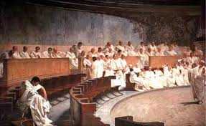
Roman Influence on Democracy
Roman Republic
Romans had established government with separate branches; like the Greeks
Consuls commanded army & directed government
Legislative Branch: Two Assemblies and a Senate
Senate: Patricians who controlled foreign/ financial policies and advised consuls
Two Assemblies: other classes of citizens
In times of crisis: republic called for a dictator
limited to 6 month term

Slide 14
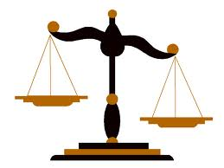
Roman Influence on Democracy
Roman Republic
Romans tried to create system of laws to be applied throughout empire
laws based on principles of reason, justice, protection of citizens and their property
Laws applied to ALL people
Written Legal Code
Romans had high regard for written law
A.D. 528 Emperor Justinian order compilation of all Roman Law
New code consisted of four works:
-The Code: 5,000 Roman laws
-The Digest: Summary of Legal Opinions
-The Institutes: Textbook for law students
-The Novellae: Laws passed after 534
Romans had established government with separate branches; like the Greeks
Consuls commanded army & directed government
Legislative Branch: Two Assemblies and a Senate
Senate: Patricians who controlled foreign/ financial policies and advised consuls
Two Assemblies: other classes of citizens
In times of crisis: republic called for a dictator
limited to 6 month term

Slide 15
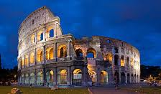
Legacy of Roman Democracy
Idea of a republic
Written legal code applied equally& impartially to all
Added to Greek ideas of democracy
Passed on democratic tradition to later civilizations
Written law established government where everyone, even the wealthy, were accountable for their actions

Slide 16
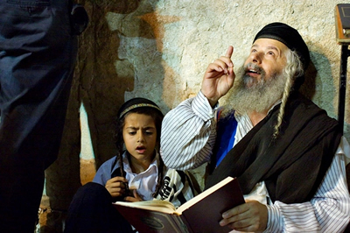
Judaism
Followers called: Hebrews/Jews
Were monotheists- Believed one God was perfect, all knowing, and all powerful
Believed God gave Jews moral freedom to choose between good and evil-emphasized worth of individual
Torah (First Five books of Hebrew Bible)= Old Testament to Christians
Stated that Hebrews had dignity by being a child of God
Different from Greeks and Romans where individuals had dignity if they can reason

Slide 17
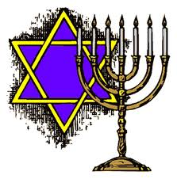
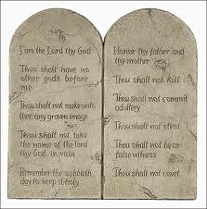
Jewish Law
Ten Commandments- basis of Jewish written law given to the Hebrew leader, Moses on Mount Sinai.
Focus of Jewish law
Morality behavior
Ethics behavior
Social behavior
Religious behavior
Less on political focus
Prophets- leaders and teachers were the
messengers of God
Strength of Jewish law focused on the worth of the individual

Slide 18
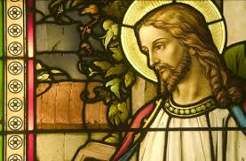
Christianity
Monotheistic religion based on teachings of Jesus Christ (christo- savior)
Emphasized people's love for God, their neighbors, enemies and themselves
Teaches that God can end evil and make eternal kingdom
People can repent for sins to find life after death
Jesus' followers (Christians) believed he died for people’s sins

Slide 19
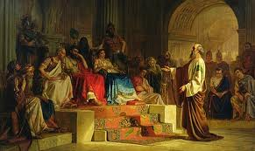
Spread of Judeo-Christian Ideas
Missionary, Paul, spread ideas across eastern Mediterranean and Roman Empire
Welcomed all converts to Christianity, Jew and non-Jew
Stressed equality of humans, belief central to democracy
Exile of Jews in A.D 70 against Romans fled to other parts of world
Shared beliefs in right of justice and dignity
Christianity, powerful and official religion
of empire by 380

Slide 20
Christianity
Spread of Judeo-Christian Ideas
Missionary, Paul, spread ideas across eastern Mediterranean and Roman Empire
Welcomed all converts to Christianity, Jew and non-Jew
Stressed equality of humans, belief central to democracy
Exile of Jews in A.D 70 against Romans fled to other parts of world
Shared beliefs in right of justice and dignity
Christianity, powerful and official religion
of empire by 380

Slide 21
Citations
http://schoolworkhelper.net/wp-content/uploads/2011/06/Greek-Democracy-History-1.jpg
http://www.darronsmith.com/wp-content/uploads/2012/11/EarlyChristiansPic.jpg

